Slide 1

KS3 Literacy - Story Structure
So you are
writing
a story?
You want it
to be good.
You have
little
time.
I’m here
to help.
To reveal how most stories are structured.
And my aim?
Notes:
Y7 Writing 5
Y7 Writing 5

Slide 2
Why is it a good idea to structure your story carefully?
to help you plan your story
to avoid a story that rambles on and on
so that you don’t run out of ideas
to ensure that your story is gripping

Slide 3
Here is the format or pattern that stories often follow.
Unfortunately I have muddled up the order.
Can you sort them into the right order?
the opening
developing the story
the complication
the crisis
the resolution
the resolution
the crisis
the complication
the opening
developing the story

Slide 4
So what do all these terms mean?
Look at the following definitions and see if you
can match them up to the right term.
1. This word means the
ending of the story, when
the crisis has passed, and
events are sorted out.
2. This is when we are
introduced to the story.
It should interest us, so
we want to read further.
crisis resolution
opening complication
crisis resolution
opening complication

Slide 5
3. This is the peak point
of the action, or the
climax.
4.This refers to problems
or uncertainties in the
plot.
development crisis resolution complication
development crisis resolution complication
If you’ve been following carefully, you’ll spot that this
leaves ‘development’, which is where more of the plot
is revealed, and we learn more about the characters.

Slide 6
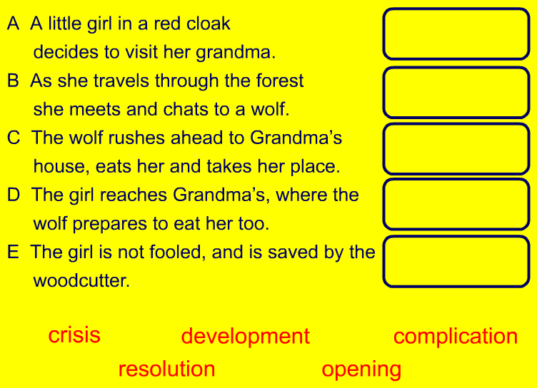
Here is the outline of a story. Use the terms you have learnt to label the different parts of the structure.

Slide 7
Now choose a story that you all know and analyse the structure.
Title:
opening
development
complication
crisis
resolution
Once you have analysed one story as a class, analyse some other stories in pairs. You could create a class display.

Slide 8
The Opening
It’s very important to create a good opening
to a story, if you want your reader to read on.
Writers use the opening of a story to
grab attention
give hints of the story to come
introduce the main characters
set the scene and the mood

Slide 9

Look at this opening to a story.
Nightmares never come true, do they? This is what
Liam told himself as he rowed slowly across the lake.
The moon glistened on the water and an owl hooted,
but Liam didn’t see or hear either. He only saw the
dark island ahead of him.
In pairs, make notes on :
the type of story (genre)
the character
the setting
the mood
Comment too on the
first sentence,
and any other features
of the language used.
Notes:
Genre: there are signs that this is to be a mystery or perhaps a horror story.
Character: Liam is rowing ‘slowly’, perhaps because he does not wish to be seen or heard. He is intent on his task, as he does not notice things around him.
Setting: at night, in darkness. The ‘dark island’ seems rather ominous.
Mood: tense and rather frightening perhaps.
First sentence: this is a rhetorical question and with its mentions of nightmares, helps to hook the reader and set the atmosphere.

Slide 10
Development
You should have ‘hooked’ your reader with the
opening. Now you need to develop ideas and
give more information. You should reveal more
about:
the plot
the characters
the setting
You are likely to use lots of description,
and to give more hints of problems to come.

Slide 11
Development
Read a further extract from our story.
Liam hesitated and looked ahead. A flight of cold,
grey, stone steps wound upwards and out of view.
A cold breeze brushed his face. He heard a voice,
his sister’s voice, speaking softly. Then there was a
loud crash, followed by silence.
What does this extract tell us about plot, setting
and character? See if you can answer these questions.

Slide 12
Development
CHARACTER
Which word tells us
that Liam is anxious:
a) softly
b) brushed
c) hesitated
PLOT
Liam is:
a) searching a haunted house
b) searching for his sister
c) escaping from danger
SETTING
Which details suggest that Liam is in a old castle:
a) cold, grey, stone steps b) cold breeze
c) loud crash

Slide 13
Complication
Writers add complications or problems to stories
in order to:
add interest and excitement
keep the reader engaged

Slide 14
Complication
Read more of Liam’s story.
There were so many rooms to search, but he must
find her. He was the only person who could help her now.
Calling her name, he ran down the long hallway. As he
turned the corner, he was unprepared for what met him.
In pairs, decide what the complication could be.

Slide 15
Crisis
This is the climax of the story. It should be:
tense
exciting
believable
absorbing
On the next slide, read two versions of the crisis point
in Liam’s story. Discuss which you prefer and why.

Slide 16
Crisis
A. Liam found Jo in the furthest room, guarded by a
huge black dog. He swiped at the dog with the stick
he held and it fled whimpering. He caught up Jo’s
hand and led her quickly away.
B. A black dog growled menacingly as he approached
Jo. Then, without warning, it lunged at Liam. His stick
was useless again this brute. The dog knocked him
backwards, and he smelt its putrid breath. In desperation,
he heaved the stick upwards and felt it pierce the dog’s skin.
As the dog lay wounded, he grabbed Jo’s hand and ran.

Slide 17
Resolution
The resolution is the ending of the story.
It should:
bring the story to a satisfactory end
tie up loose ends/problems in the story
It may:
be humorous
be sad
have some uncertainty, like in some films

Slide 18
Resolution
Read the resolution to our story.
Discuss whether you find it satisfactory.
How else might the story have ended?
Liam and Jo, sat exhausted in the back of the car. Their
parents seemed to have difficulty believing their story,
but who would believe a story about wizards and spells?
The police had found no one in the castle. They had said
it was deserted. But that was what Liam had thought when
they had first been there. Still, he was looking forward to
the rest of the summer holidays, and he definitely wouldn’t
be reading the latest Harry Potter book!

Slide 19
Plenary
A clear sense of structure is essential for
effective story writing. Remember it will help you:
plan
think of ideas
keep to an exciting story
avoid rambling on and on
Run through the five point plan again.
Look out for it in the stories you read and use
it in your own writing to help your stories work
- like magic!

